Slide 1
Meninges and Spinal Cord
Day 3

Slide 2
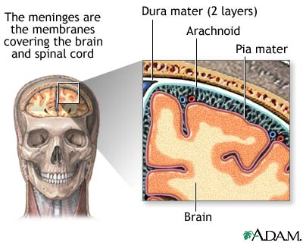
Meninges
Covers brain and Spinal cord
3 layers
Dura
Arachnoid
Pia

Slide 3
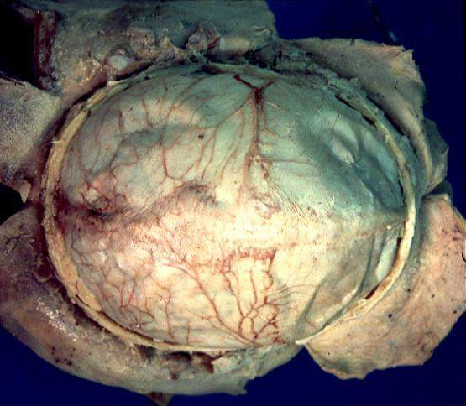
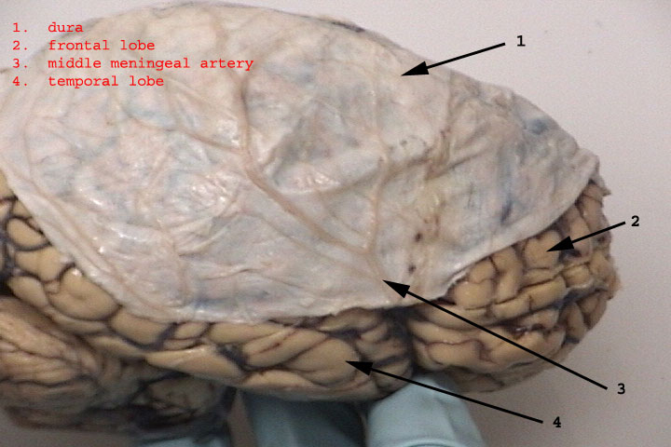
Dura Mater
Outer most layer
Tough, white fibrous connective tissue
Contains many blood vessels and nerves
Forms sheath around spinal cord
Epidural space
Made of loose connective tissue and adipose tissue
Provides a protective pad around spinal cord

Slide 4
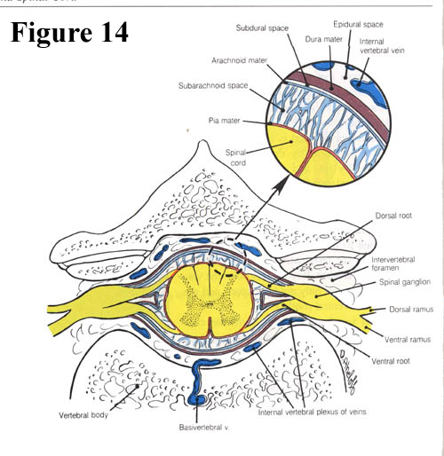
Arachnoid Mater
Thin, net-like membrane
Lacks blood vessels
Found between dura and pia mater
Spreads over brain and spinal cord
Subarachnoid space
Contains cerebrospinal fluid (CSF)
Clear watery fluid

Slide 5
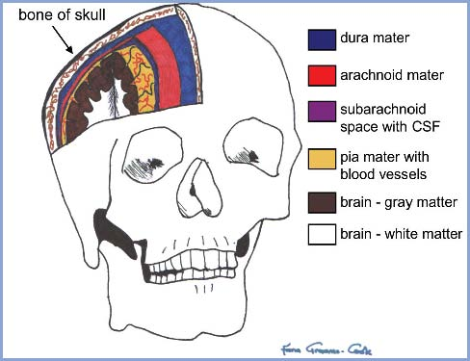
Pia Mater
Very thin
Contains many nerve and blood vessels that aid in nourishing the underlying cells of the brain and spinal cord
Attached to brain and spinal cord

Slide 6
Meninges Review
What are the meninges?
What are the layers of the meninges?
Where is cerebrospinal fluid located in the meninges?

Slide 7
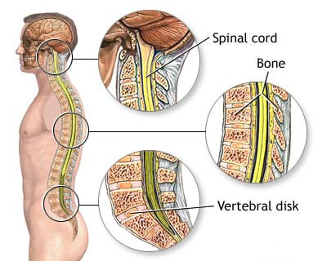
Spinal Cord
Slender nerve column that passes downward from the brain
Starts at the foramen magnum
Ends at the intervertebral disk that separates L1 and L2

Slide 8
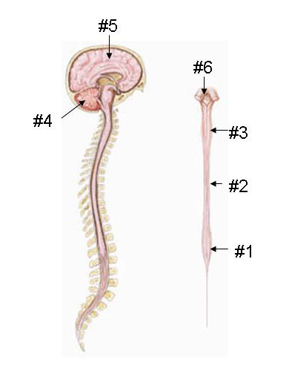
Structure
31 segments-each give rise to a pair of spinal nerves
Cervical Enlargement
In neck, supplies nerves to upper limbs
Lumbar Enlargement
In lower back, supplies nerves to lower limbs

Slide 9
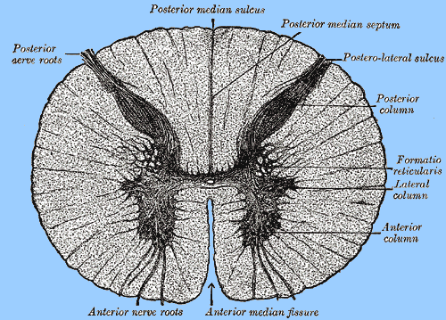
Spinal Cord Structure Cont.
Two Grooves
Anterior median fissure
Deep
Posterior median sulcus
Shallow
Divide spinal cord into R and L halves

Slide 10
Gray or White?
Spinal Cord is made up of gray and white matter.
Gray matter resembles a butterfly
Gray matter makes up the horns
Posterior, Anterior, and Lateral
White is divided into funiculi by gray matter
Anterior, Lateral, and Posterior funiculi

Slide 11
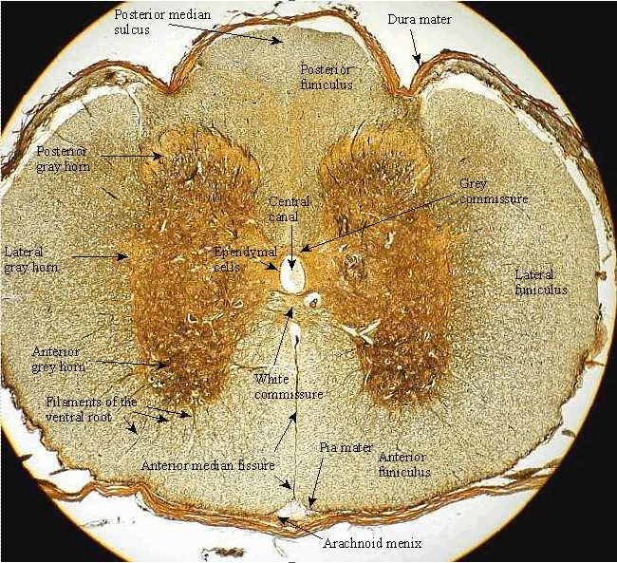

Slide 12
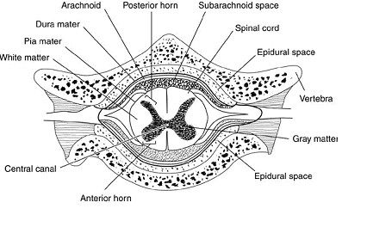
Structure Cont.
Nerve Pathways = Nerve Tracts
Central Canal
Contains CSF (cerebral spinal fluid)

Slide 13
Function of the Spinal Cord
2 major functions
Conducting nerve impulses
Center for spinal reflexes
Nerve Tracts provide a two-way communication system between brain and body parts outside the nervous system.

Slide 14
Tracts
Ascending Tracts:
Carry sensory info to brain
Descending Tracts
Conduct motor impulses form the brain to muscles and glands
Names of tracts are determined by origin and termination points
Example: spinothalmic tract starts in the Sp.C. and ends in the thalamus of brain.
Nerve Fibers within A and D tracts are called AXONS

Slide 15
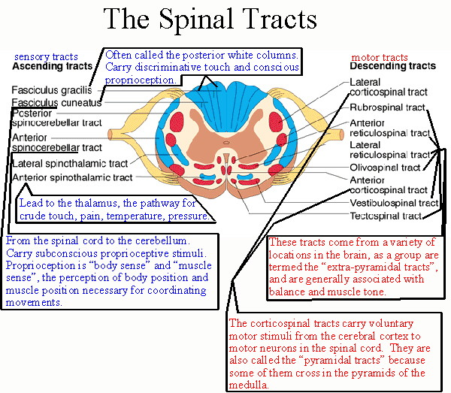

Slide 16
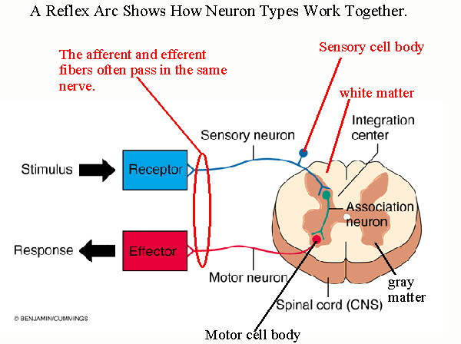
Spinal Functions Cont.
Spinal Reflexes
Withdrawal and knee-jerk reflexes pass through spinal cord

Slide 17
Spinal Cord Review
Describe the structure of the spinal cord.
What are some general functions of the spinal cord?
How do you distinguish between the ascending and descending tracts of the spinal cord?

